Slide 1
Development of Massive Parallel Current Measurement Hardware for Application in EIT
Ahmad Nafis Khan Suprotik
Matriculation No: 21864790

Slide 2
Agenda
Theoretical Approach
Hardware Design Procedure
Simulation Analysis
Layout Design Description
Conclusion

Slide 3
The Primary Requirement of the Project Work
Implementing a measurement system with a large number of electrodes in the persuasion of maximizing the projection of conductivity of certain process volumes in the field of the chemical reactor to comprehend the internal changes in terms of temperature distribution, species concentrations, etc.
In this aspect, a hardware design or a reference Analog Front End(AFE) needs to be developed which possibly scales the required number of electrodes (like hundreds or more) with respect to the applications.
For multichannel data acquisition and sampling systems, high-speed data conditioning with a maximized signal-to-noise ratio (SNR) has been posed as special consideration in terms of performance metrics.
3
21.07.2022

Slide 4
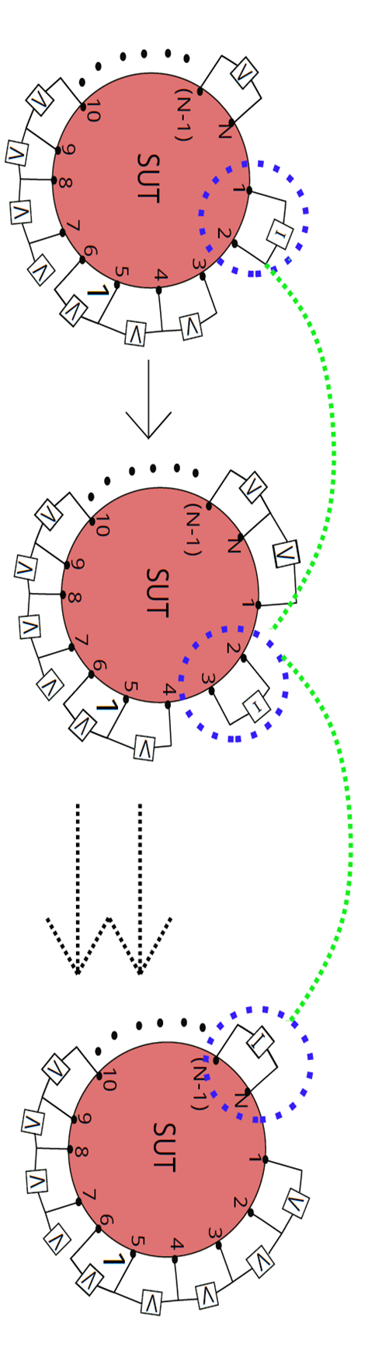
The Classification of EIT Instruments
Current Mode EIT (CV-EIT):
4
Generic measurement scheme of CV-EIT for N number of electrodes.
The process is supposed to be continued until every possible pair of electrodes are current injected ones( referred as "I" in the block).
21.07.2022

Slide 5
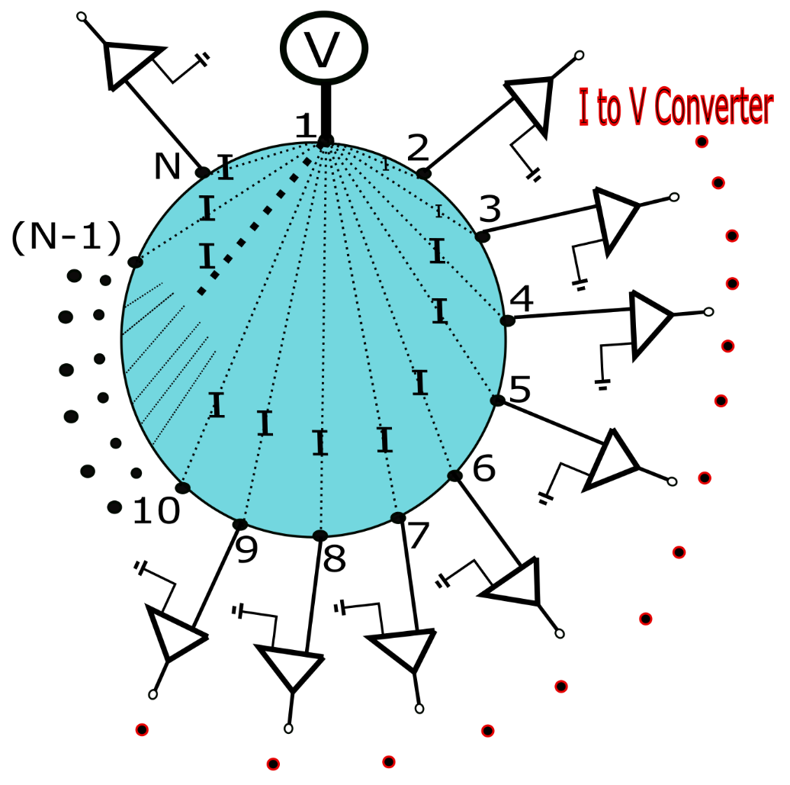
The Classification of EIT Instruments
Current Mode EIT (CV-EIT):
Different from Pattern Excitation scheme.
Voltage signal is injected between one source electrode and other electrodes which are working as sink electrode.
Current Data are measured successively from all electrodes at a time except the injecting electrode.

Slide 6
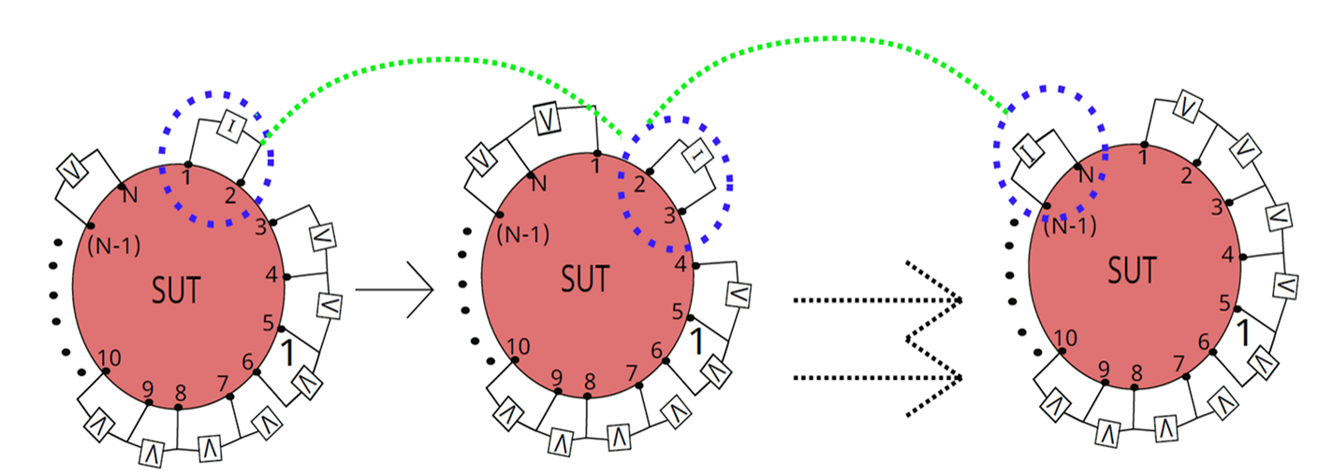

Comparative analysis Between CV-EIT and VC-EIT
The increase in the sensitivity to the electrode size and placement configurations matters
Compensating the trade-off in terms of frequency and conductance measurement.
unknown contact impedance issues which effect the constructed image quality more into the VC-EIT rather than in the CV-EIT system

Slide 7
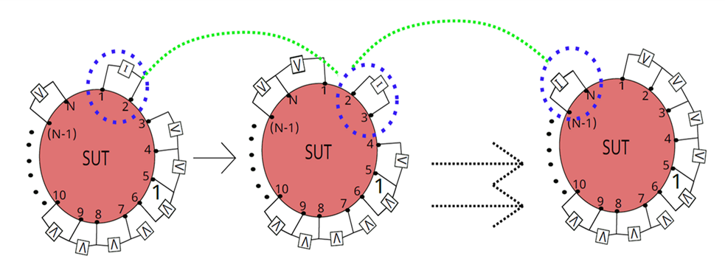
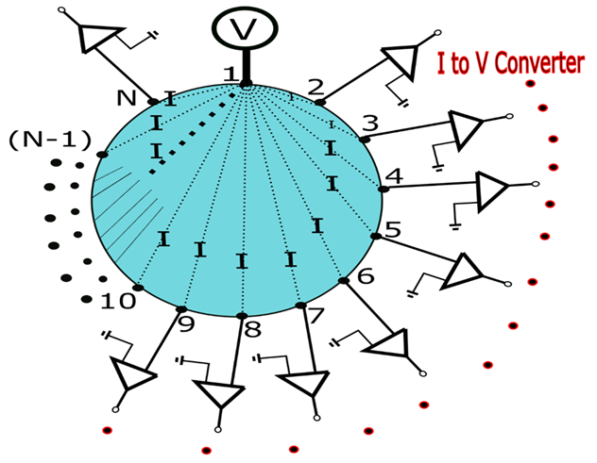
Comparative analysis Between CV-EIT and VC-EIT
The increase in the sensitivity to the electrode size and placement configurations matters
Compensating the trade-off in terms of frequency and conductance measurement.
unknown contact impedance issues which effect the constructed image quality more into the VC-EIT rather than in the CV-EIT system
General Scheme (CV-EIT)
General Scheme (VC-EIT)

Slide 8
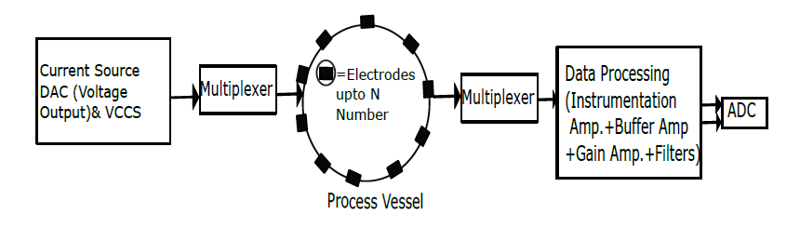
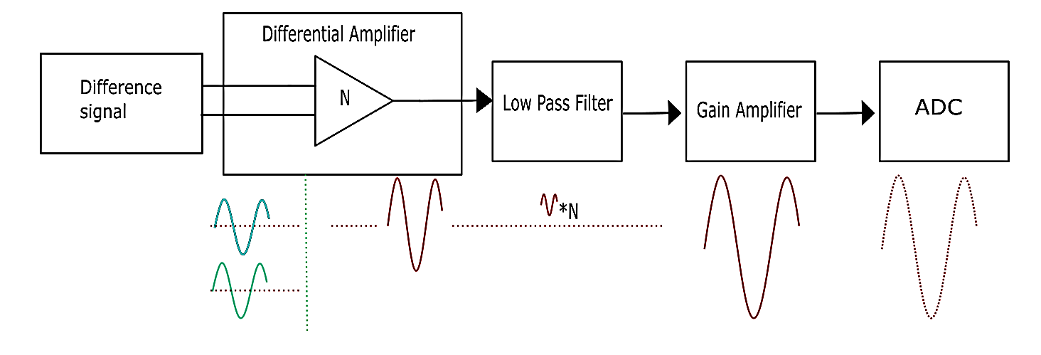
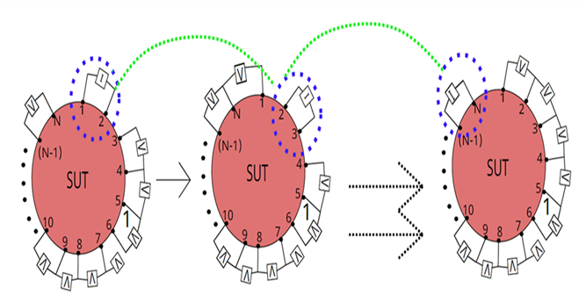
Conventional EIT System AFE Architecture
Source
Sink
Electrode Pair management
Source or Sink
Multiple Mux
Conventional block diagram of popular current mode EIT scheme.

Slide 9
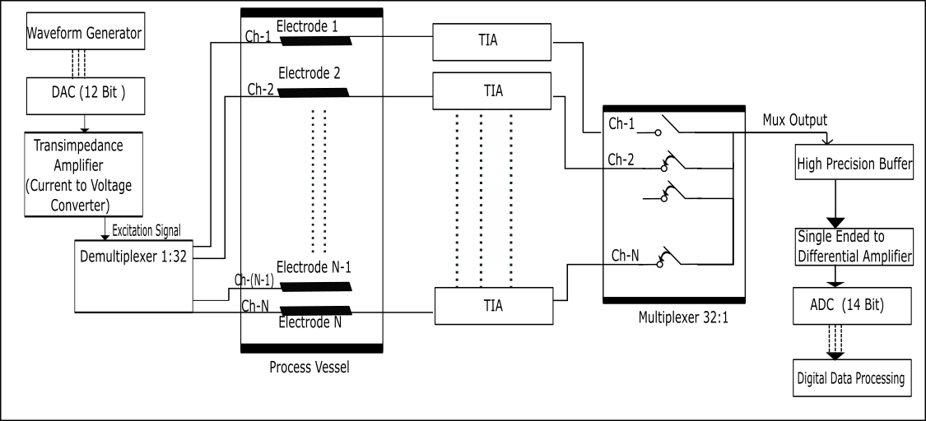

Proposed EIT System Analog Front End(AFE) Architecture
Source
Sink
Data Recording Sequence
Scheme: Semi Parallel
(for example: in case of 96 electrodes system, every 32 electrode set’s data acquisition will be done sequentially through MUX switching while 3 ADC will provide 3 set of data in parallel; every set contain 32 electrodes information
Block diagram of proposed hardware scheme based on VC-EIT Scheme

Slide 10
Theoretical Approach
Hardware Design Procedure
Simulation Analysis
Layout Design Description
Conclusion

Slide 11
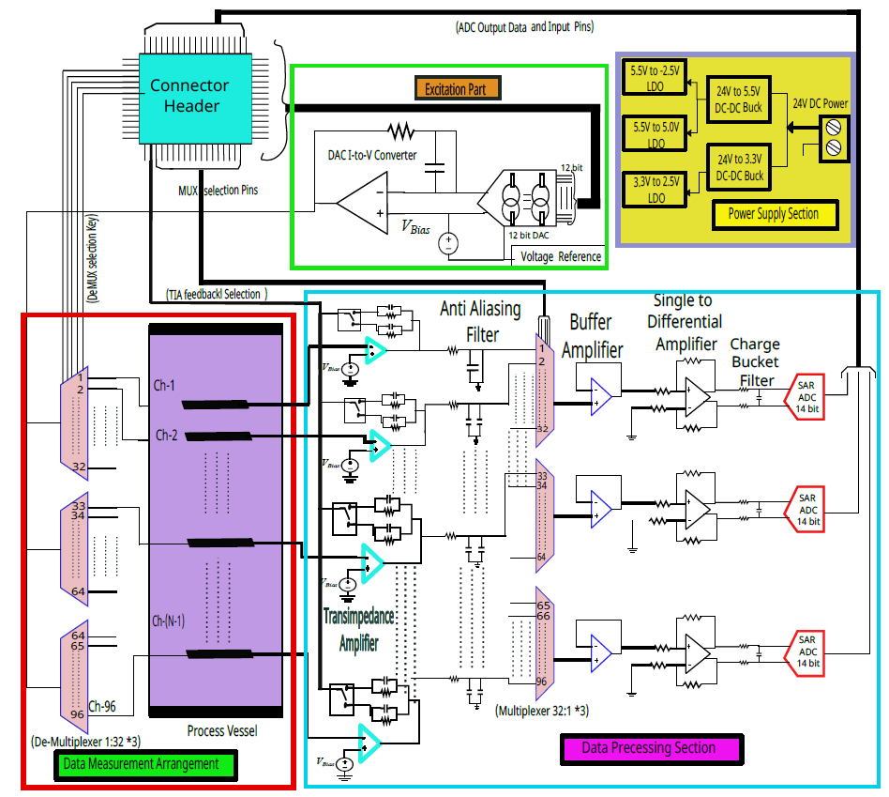
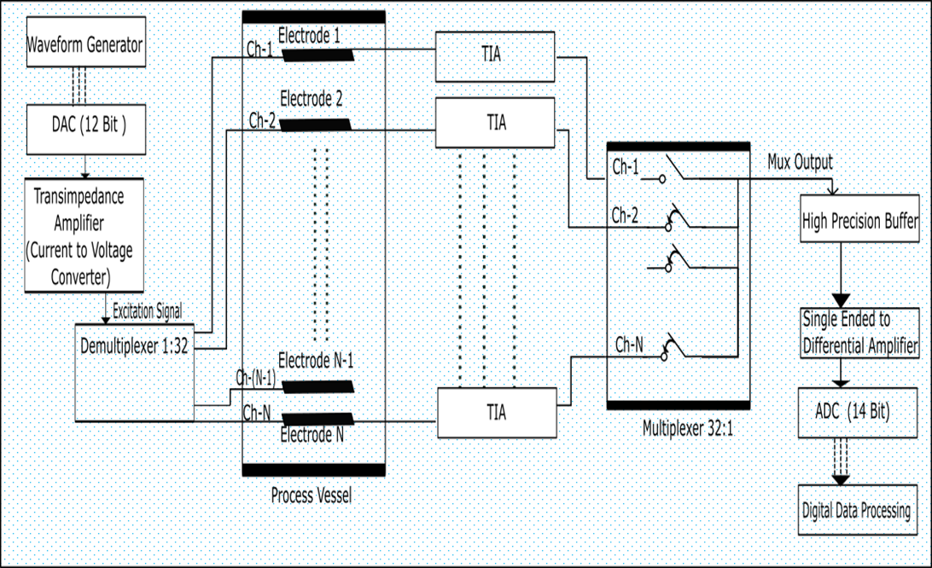
Simplified Schematic Block Diagram
Figure: Proposed Scheme block (Left) and Simplified Schematic block Diagram (Right)
Power Supply Section
Excitation Generation Section
Data Measurement Arrangement Section
Signal Data Processing Section
Notes:
11

Slide 12
Hardware Design Steps
Power Supply Section
Excitation Generation Section
Data Measurement Arrangement Section
Signal Data Processing Section

Slide 13
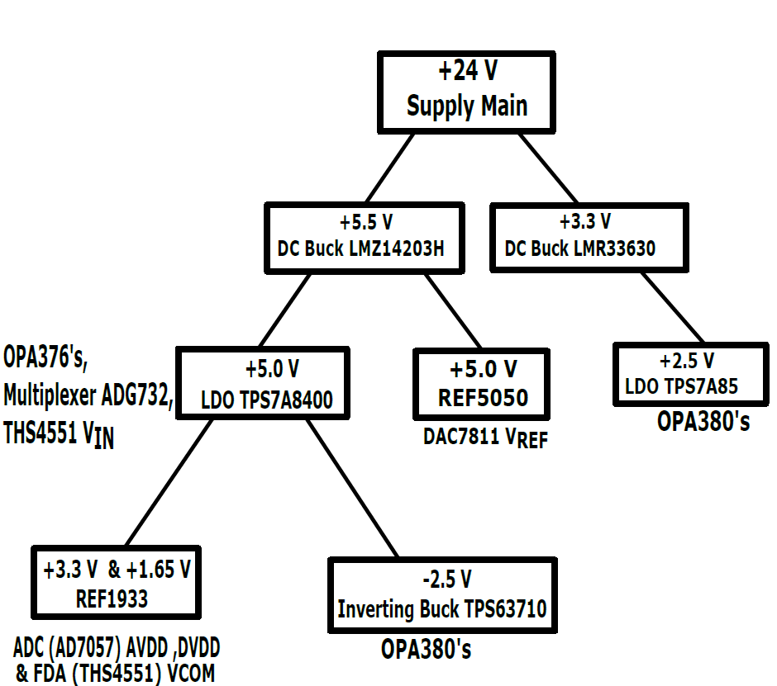
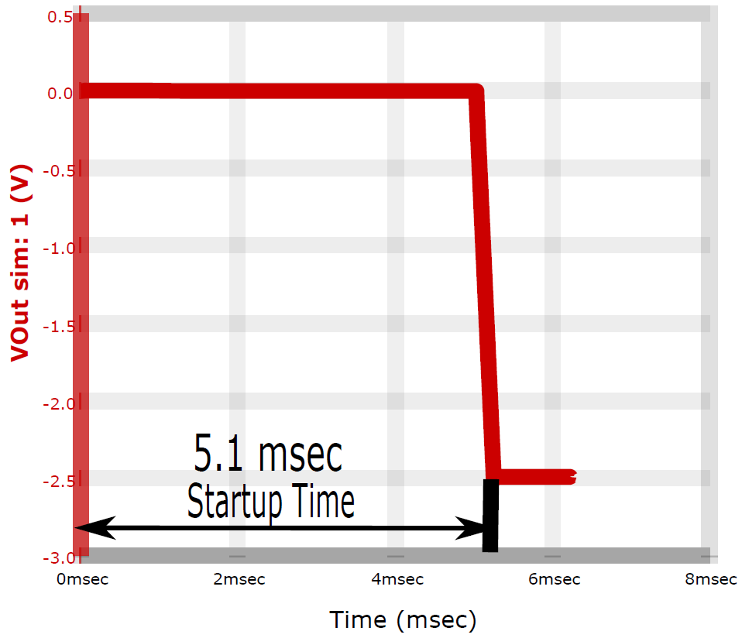
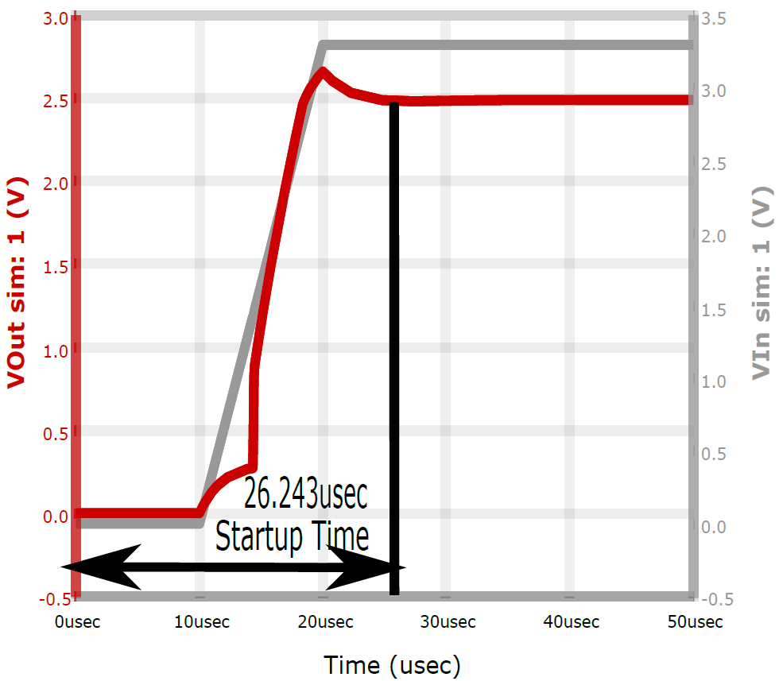
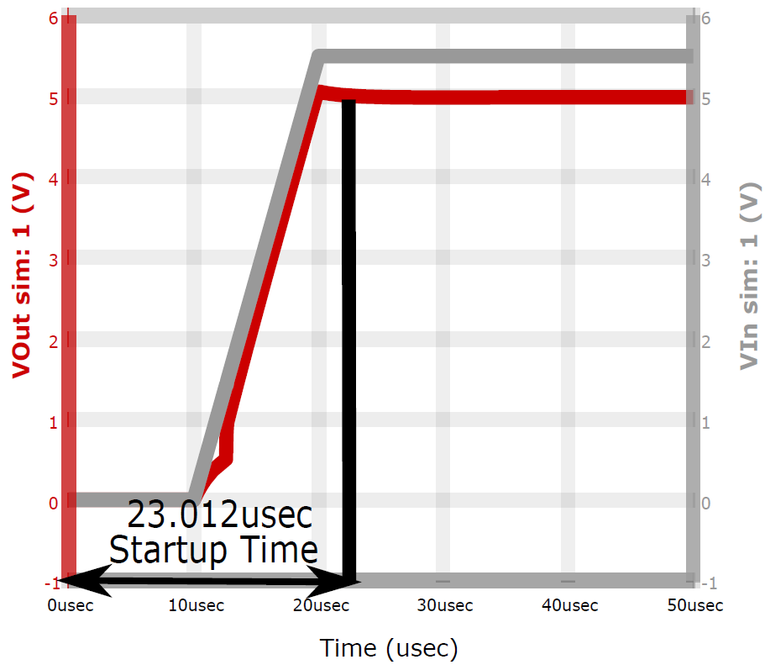
Power Supply Section Graphs
Figure :
IC Startup time simulation through "Webench Power Designer" software for - 2.5V(top),
5V(Bottom-left),
2.5V(Botttom- Right)
Figure :System power tree

Slide 14
Hardware Design Steps
Power Supply Section
Excitation Generation Section
Data Measurement Arrangement Section
Signal Data Processing Section

Slide 15
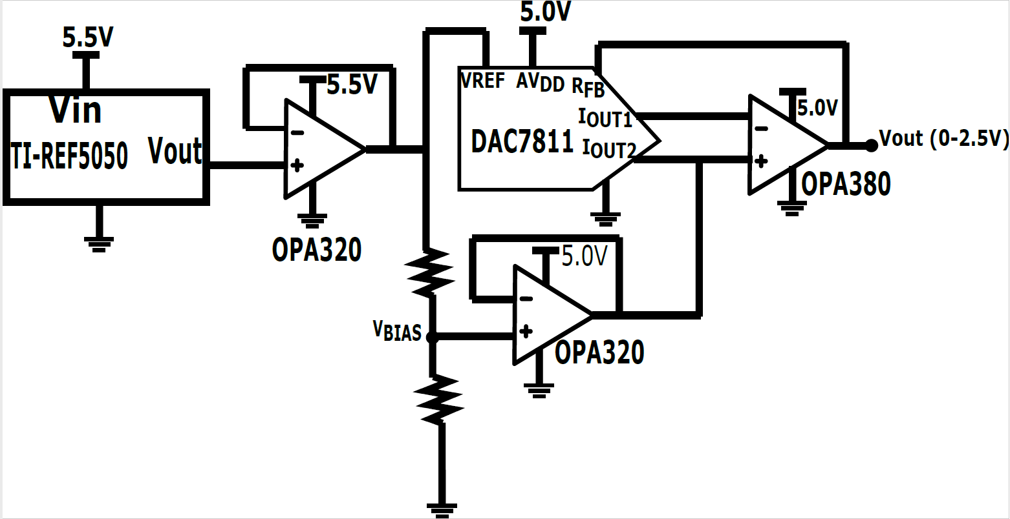
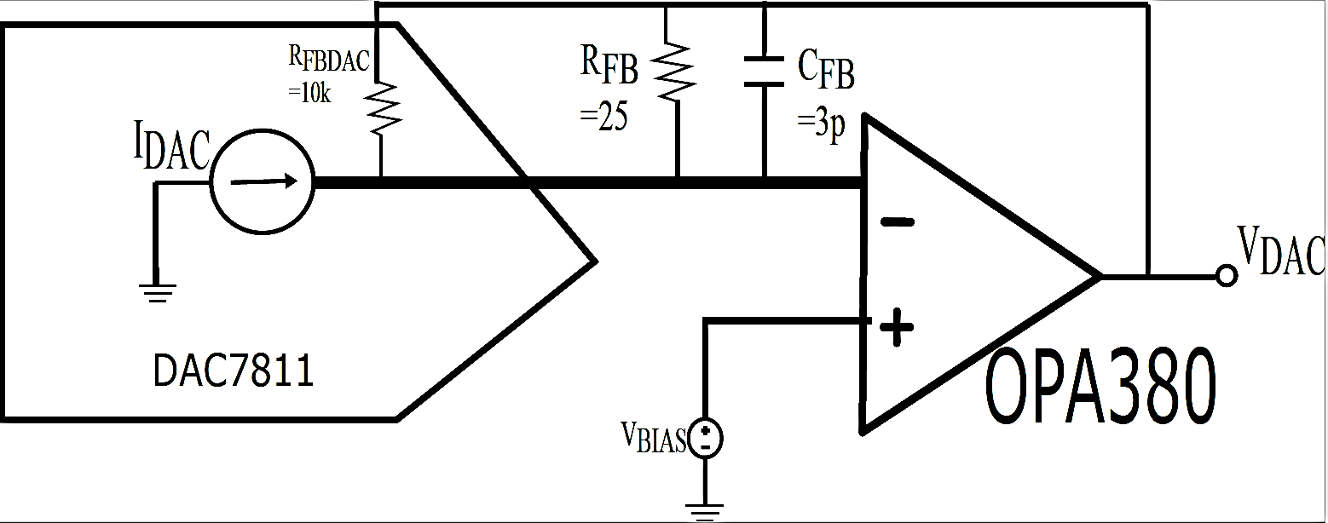
Voltage Excitation Part
DAC 7811 :
the Multiplying DAC(MDAC) has been chosen as it the reference drive does not need to settle every time the code has been changed to reform the output, that reduces the glitch energy and has fast the settling time.
OPA380 :
Texas Instrument’s OPA380 has been chosen for the external Transimpedance amplifier of the MDAC because OPA380 has extremely low output offset voltage(VOS) i.e. 4μV and input offset current IOS(±50 pA) as well as slew rate of around 80 V/μs.
The frequency of the excitation voltage | 10kHz to 100kHz
Calculated Feedback Value | 25Ω and 3 pF
Baising Voltage | 2.5 V
Generated Excitation Voltage | 60mV Peak to peak with DC level 1.05 Volt.
15
Figure: DAC Peripheral circuit with Passive Elements
22.07.2022

Slide 16
Hardware Design Steps
Power Supply Section
Excitation Generation Section
Data Measurement Arrangement Section
Signal Data Processing Section (Part1)

Slide 17
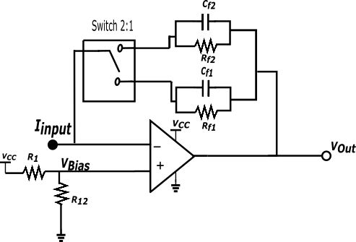
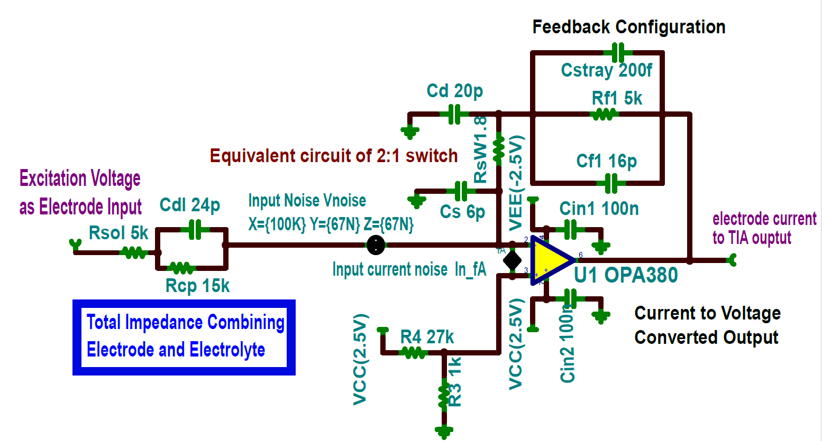
Transimpedance Amplifier (TIA) Design Process
Impedance range | Approximate measured current between source and sink electrodes | Considered phase difference
350-1000 | 900μA-2.5mA | 6°-11°
5k-20k | 48μA-190μA | 5.5°-9.8°
Figure: Modified Transimpedance amplifier circuit
Considered Impedance Range | Z=5k-20kΩ | Z=300-1kΩ
Excitation Voltage | 1.05V | 1.05V
Bias Voltage at TIA input | 89.2mV | 89.2mV
Calculated Rf | 6.7Ω | 643Ω
Rf set for simulation | 5KΩ | 240Ω
Calculated Cf | 4 pF | 4 pF
Cf set for simulation | 16 pF | 16 pF
Figure: TINA-TI Schematic of Transimpedance amplifier with multi feedback configuration
Table : Selected Transimpedance amplifier design values after stability analysis

Slide 18
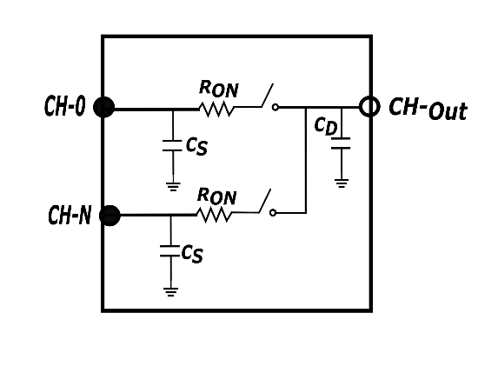
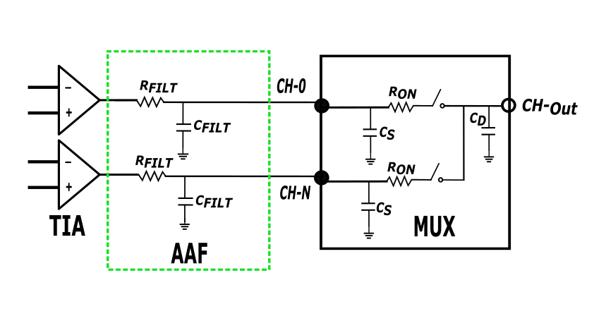
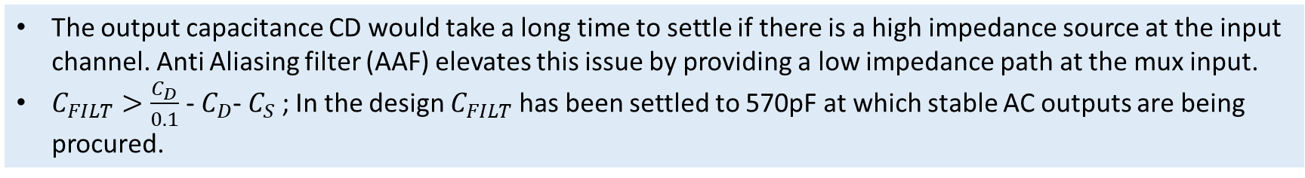
Multiplexer Driving Method
Figure : Simplified multiplexer model
Figure : AAF circuit and charge distribution circuitry
The output capacitance CD would take a long time to settle if there is a high impedance source at the input channel. Anti Aliasing filter (AAF) elevates this issue by providing a low impedance path at the mux input.
$C_{FILT}>\frac{C_{D}}{0.1}$ - $C_{D}$- $C_{S}$ ; In the design $C_{FILT}$ has been settled to 570pF at which stable AC outputs are being procured.

Slide 19
Hardware Design Steps
Power Supply Section
Excitation Generation Section
Data Measurement Arrangement Section
Signal Data Processing Section

Slide 20
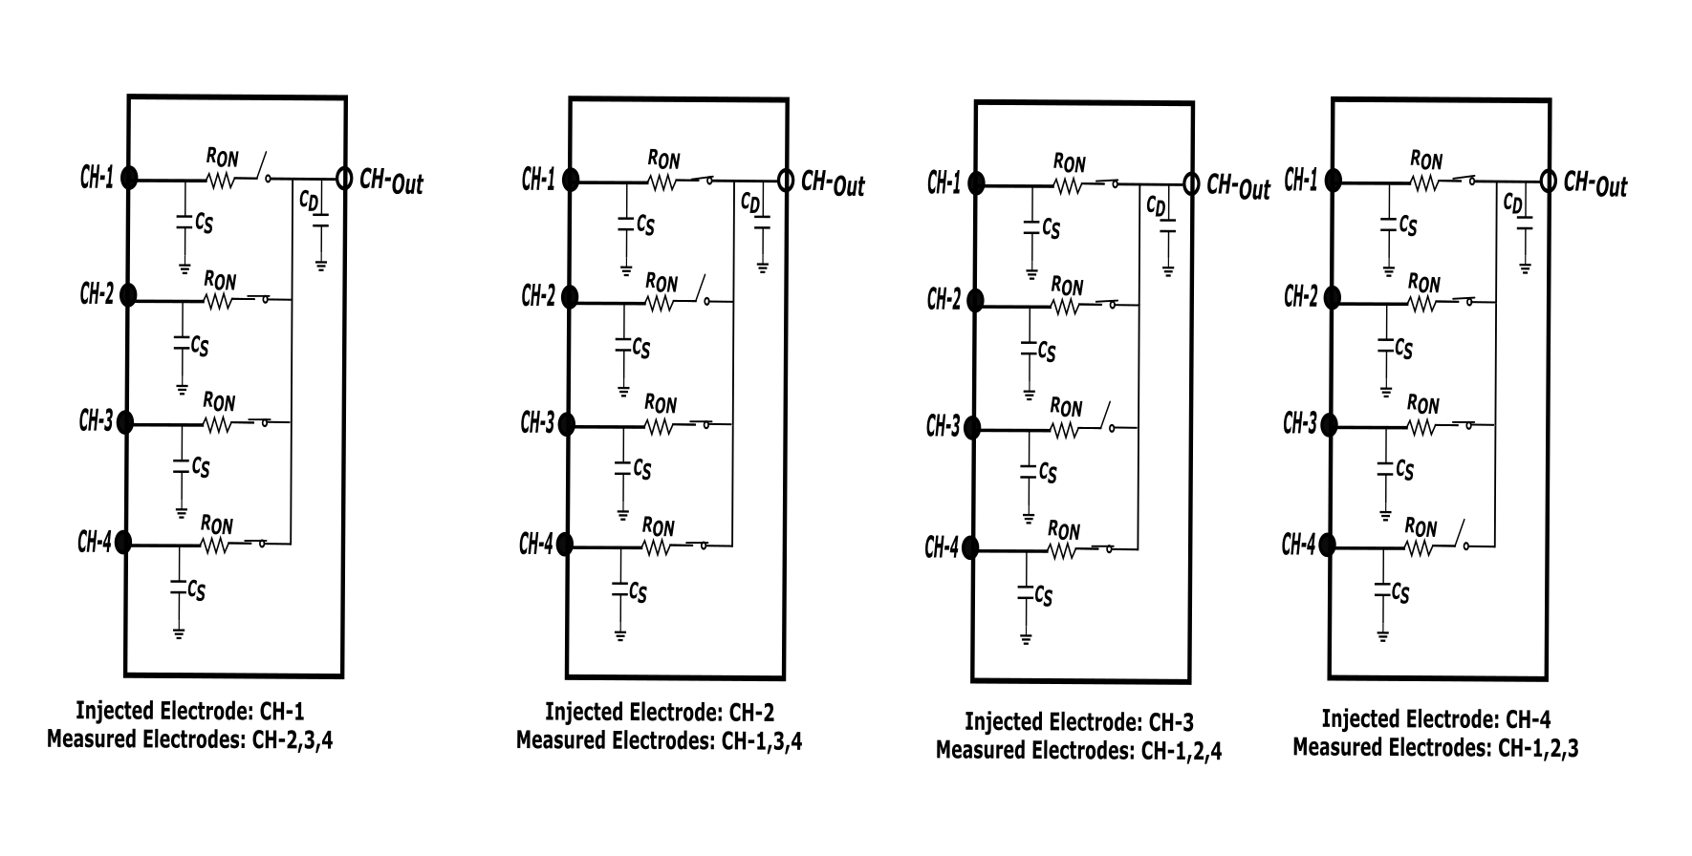
Multiplexer Channel switching sequence

Slide 21
Hardware Design Steps
Power Supply Section
Excitation Generation Section
Data Measurement Arrangement Section
Signal Data Processing Section (part 2)

Slide 22
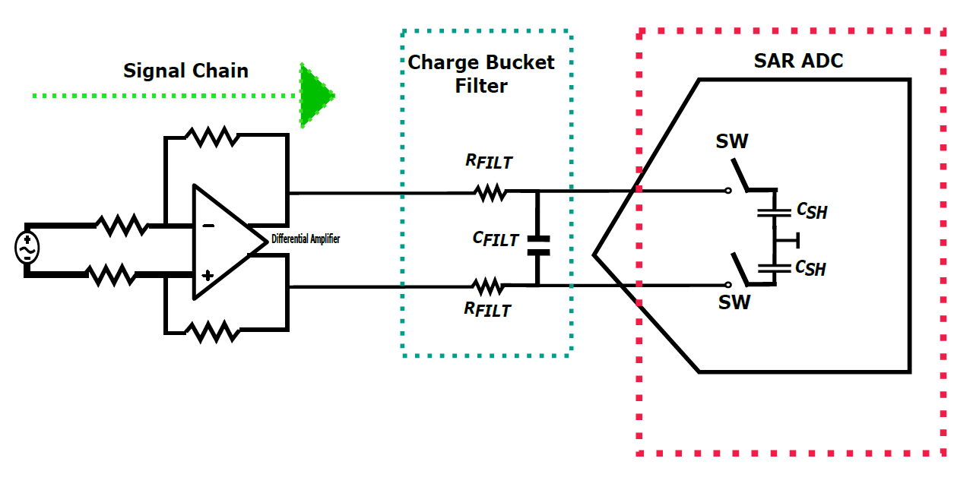
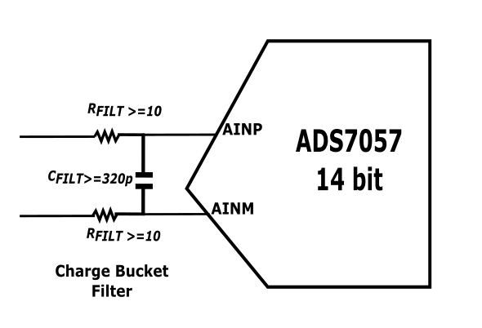
ADC Input Driver Circuit
Successive Approximation (SAR) ADC is being chosen because SAR ADCs contain the sample-hold feature with almost zero-cycle latency and a low latency time compared with the other ADC kinds like Sigma Delta or Pipeline ADC
Texas Instrument’s high precision ADC, ADS7057 has been chosen which is 14-bit, 2.5 –MSPS SAR and operates in fully differential input mode, functions as high speed data conversion with a total cycle time of 400 ns
Three Designated Design Sections:
Differential Amplifier System elements
Charge Bucket Filter
SAR ADC Equivalent Circuit

Slide 23

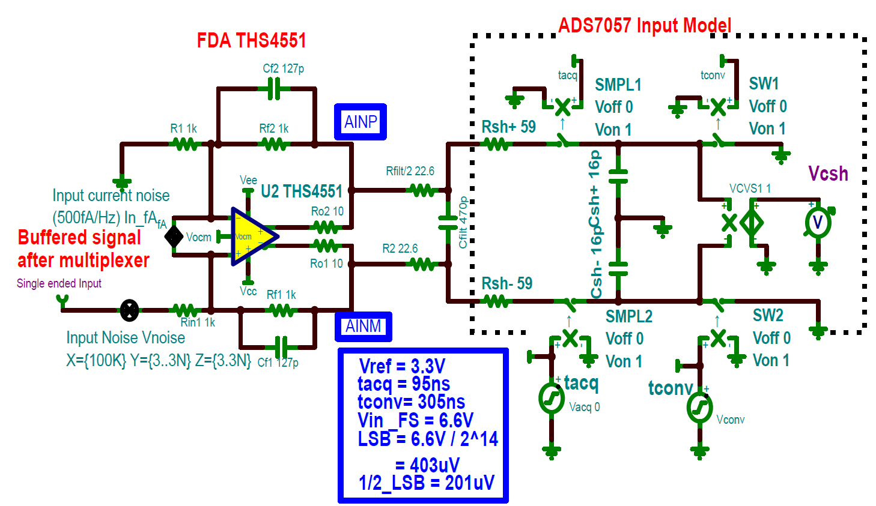
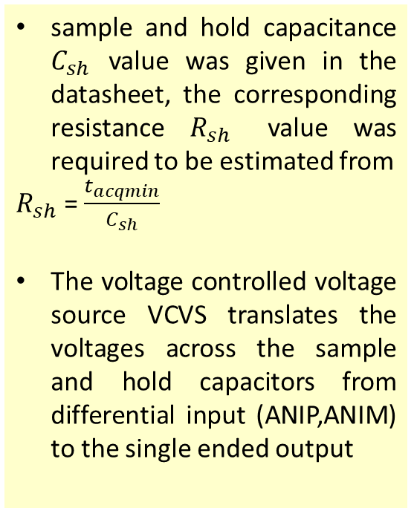
Building the SAR ADC (ADS7057) simulation model
sample and hold capacitance $C_{sh}$ value was given in the datasheet, the corresponding resistance $R_{sh}$ value was required to be estimated from
$R_{sh}$ = $\frac{t_{acqmin}}{C_{sh}}$
The voltage controlled voltage source VCVS translates the voltages across the sample and hold capacitors from differential input (ANIP,ANIM) to the single ended output
Figure: TINA SPICE equivalent model of SAR ADC driving circuitry

Slide 24
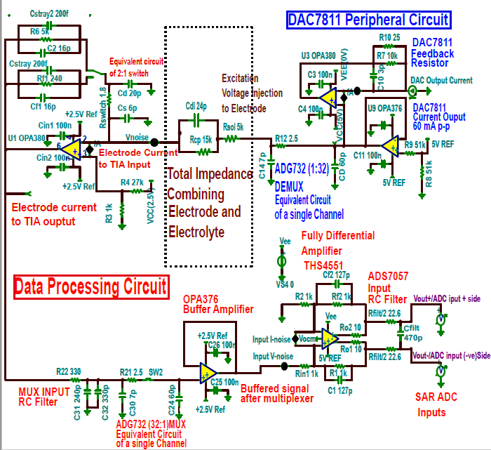
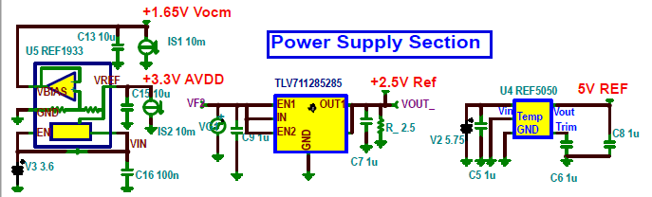
TINA-TI schematic for one single measurement channel
one single measurement channel
starting from the ’excitation voltage injection’ to the electrodes model and then
followed by the impedance data acquisition and processing portion until the data
has been being fed to the ADC(ADS7057) for consecutive digital processing

Slide 25
Simulation Result Analysis

Slide 26
Simulation Result Analysis
ADC Charge Bucket Filter Design
Stability Analysis
Noise Simulation
Settling Error Analysis

Slide 27
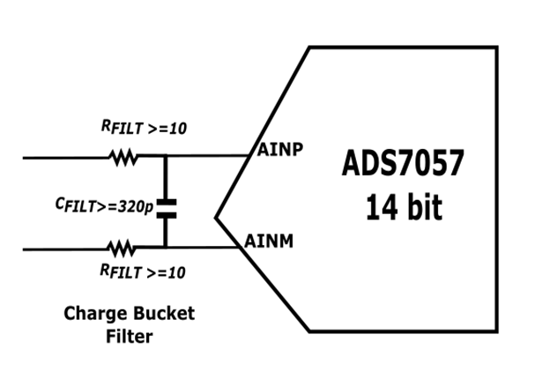
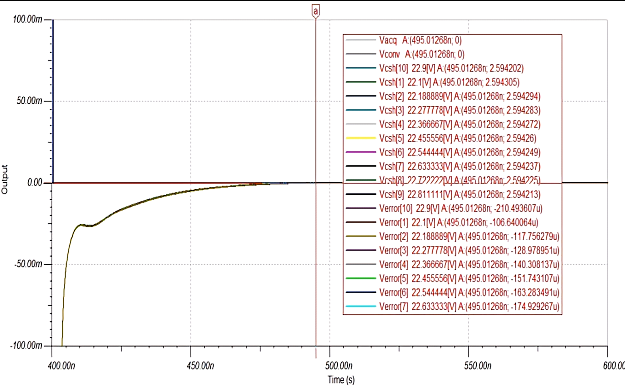
ADC charge bucket filter design Simulation
The ’Analog Design Calculator’ has been used to predict the filter values in a certain range; The calculator approximated the ranges of Rfilt/2 value was from 4.8 Ωto 46.4 Ωand the Cfilt/2 value was from 160pF to 640pF.
the parametric sweeping has been performed to check the settling error signal that was less than one 1/2 LSB i.e 201uV at the end of the acquisition cycle
the value of (Rfilt/2) around 22.6 Ω has minimum settling error margin. This same simulation process was being maintained for the selection of Cfilt/2 value (470pF)

Slide 28
Simulation Result Analysis
ADC Charge Bucket Filter Design
Stability Analysis
Noise Simulation
Settling Error Analysis

Slide 29
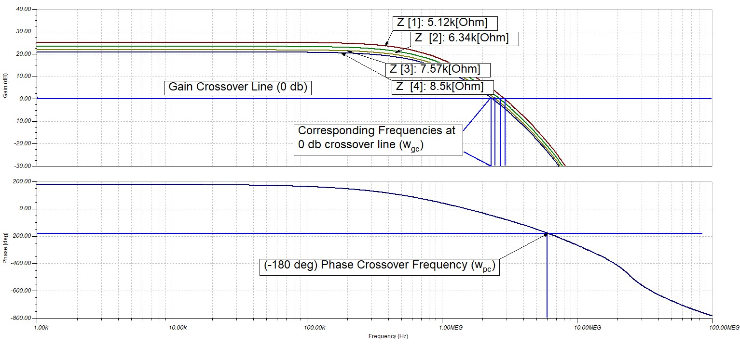
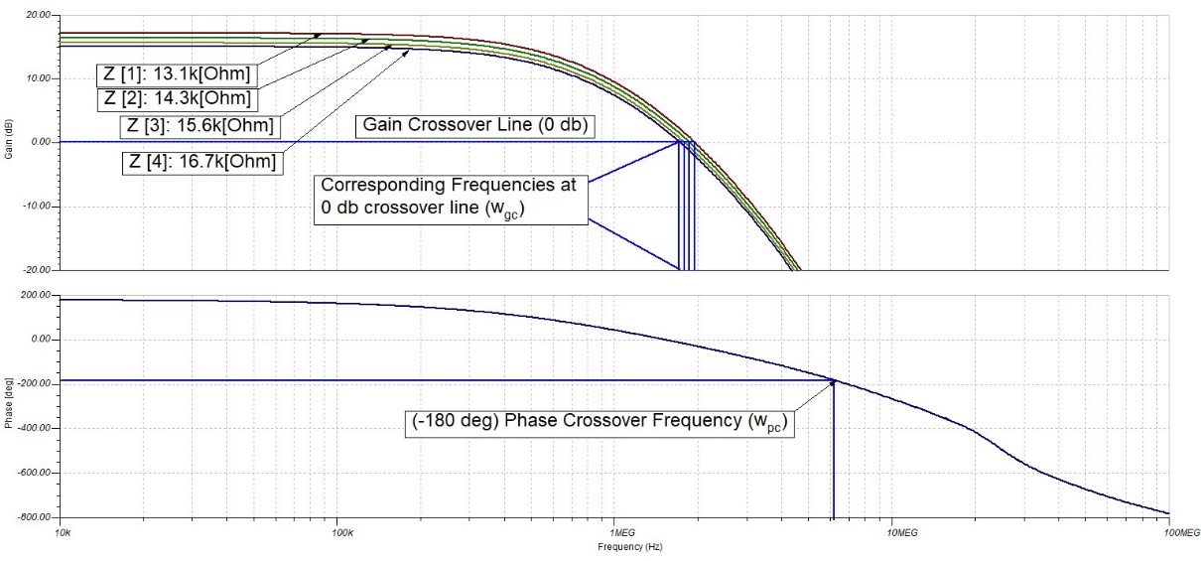

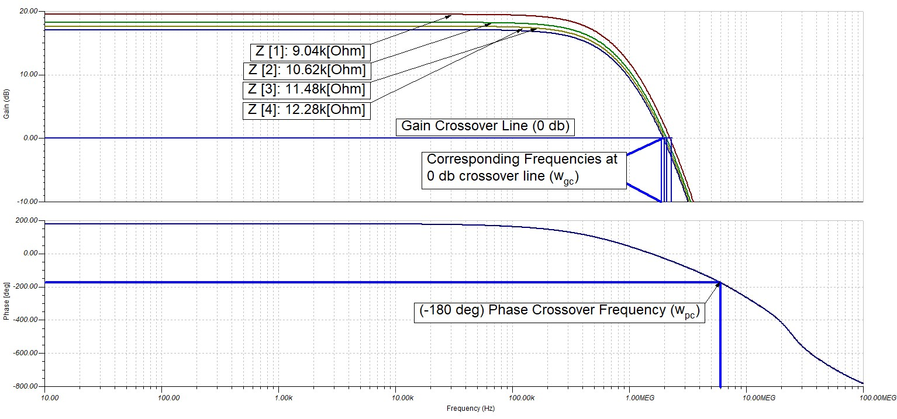
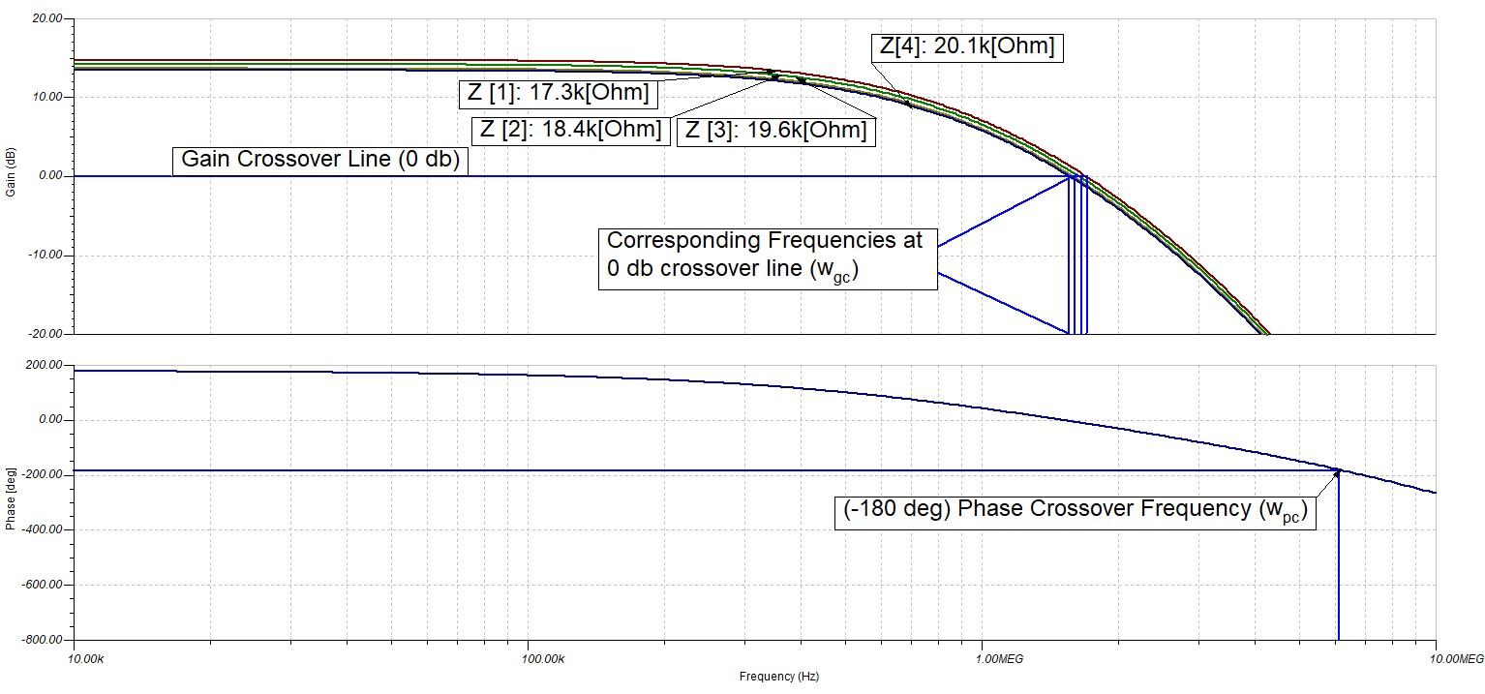

Stability Analysis for |Z|=(5k-20k)

Slide 30
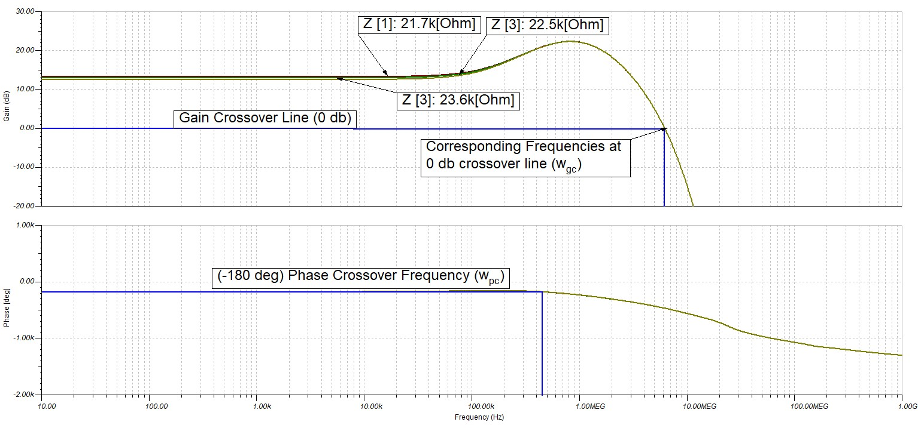
Stability Analysis for |Z|=(5k-20k)

Slide 31
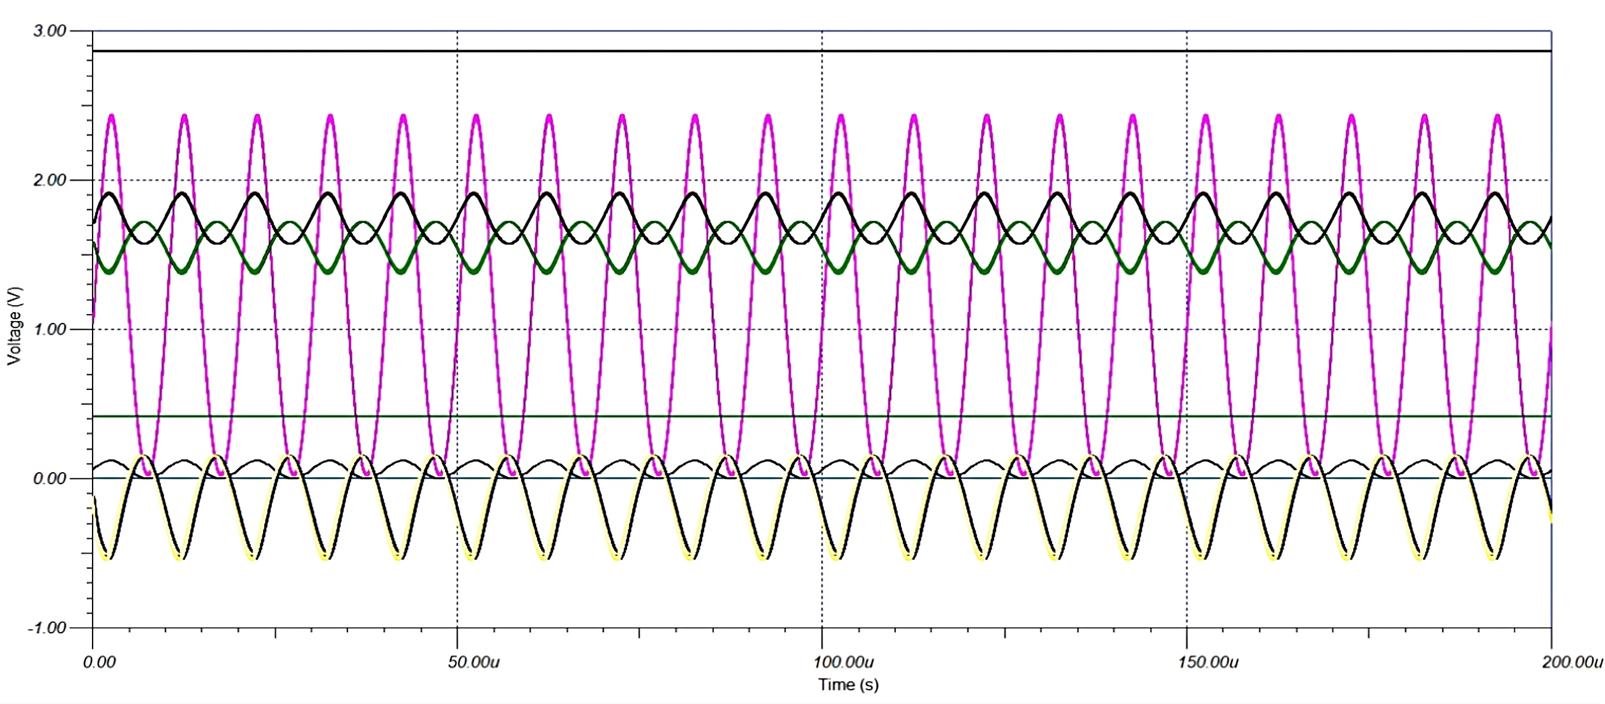
Transient Analysis for |Z|=(5k-20k)
ADC Input Signal
Excitation Voltage Signal
Electrode to TIA Ouput

Slide 32
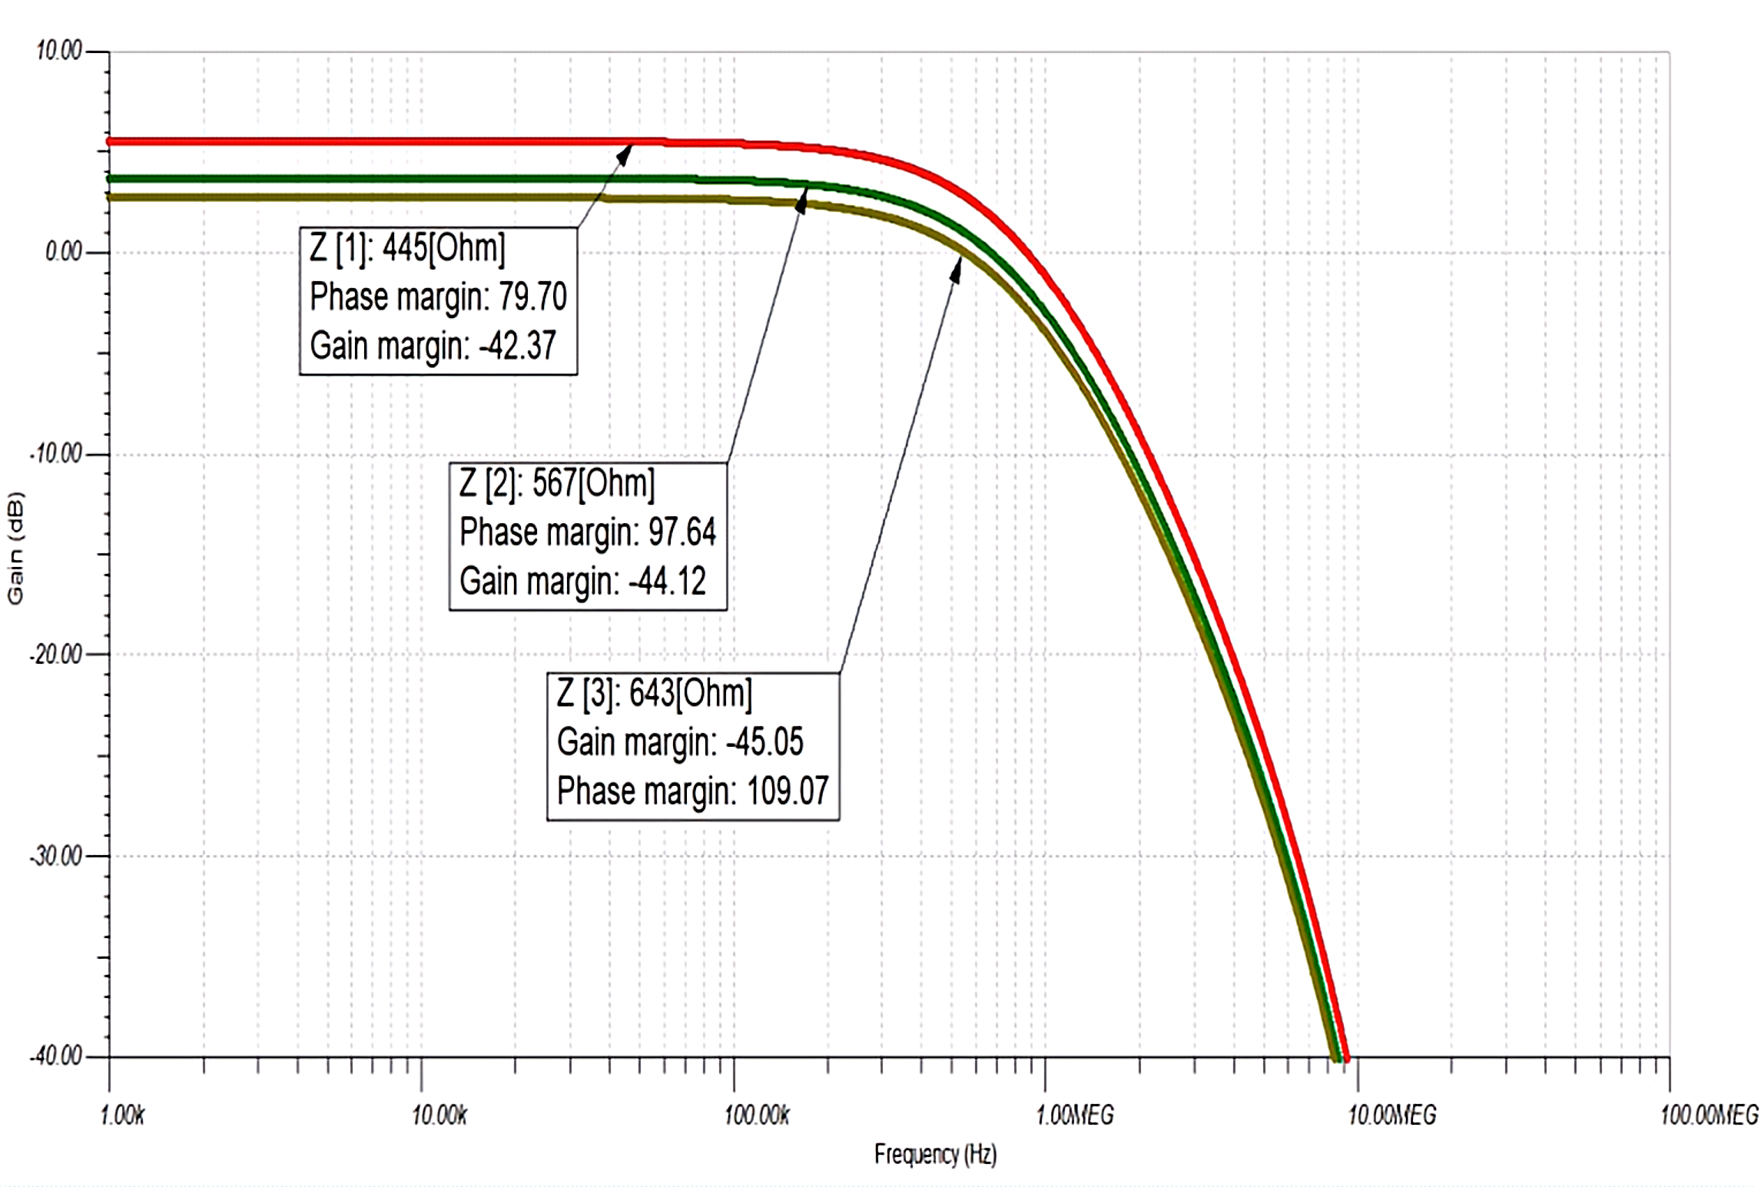
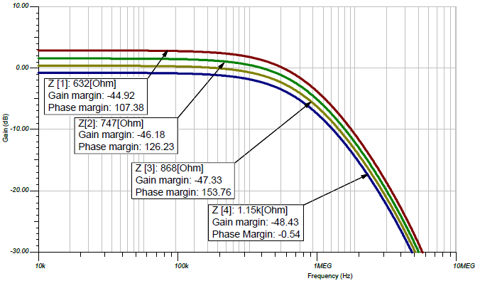
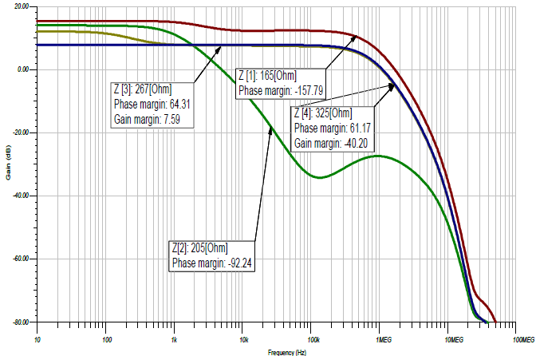
Stability Analysis for |Z|=(300-1k)

Slide 33
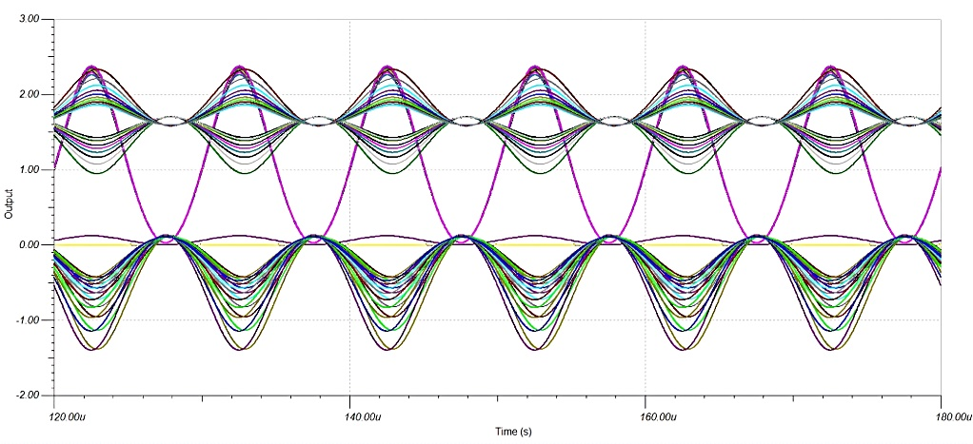
Transient Analysis for |Z|=(300-1k)
ADC Input Signal
Excitation Voltage Signal
Electrode to TIA Ouput

Slide 34
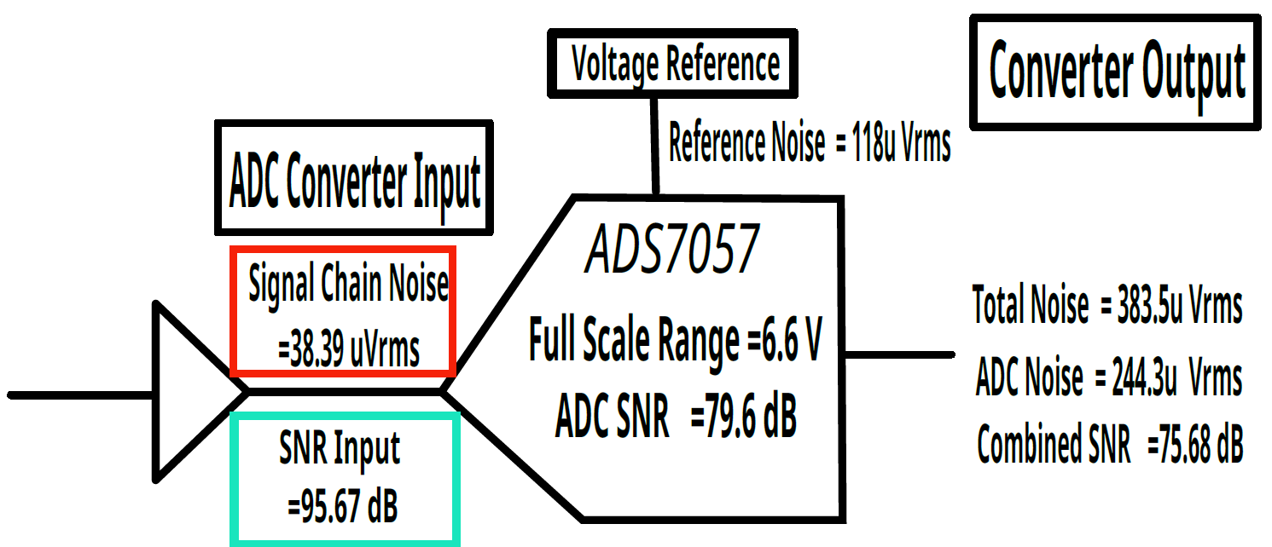
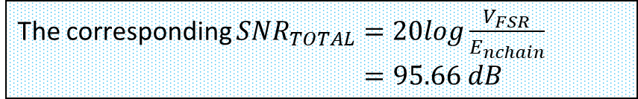
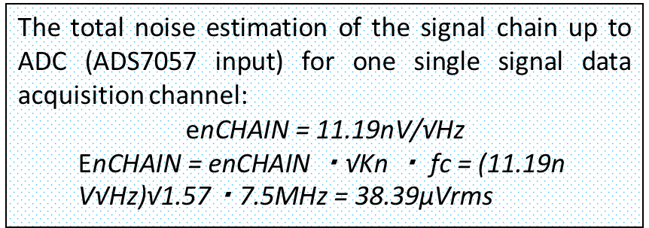
ADC input Noise Analysis
Analog Design Calculator
Hand Calculation
The total noise estimation of the signal chain up to ADC (ADS7057 input) for one single signal data acquisition channel:
$$\text{e}\text{nCHAIN}\text{ = 11.19}\text{nV}\text{/√}\text{Hz}$$
$$\text{E}\text{nCHAIN}\text{ = }\text{enCHAIN}\text{ ・√}\text{Kn}\text{ ・ }\text{fc}\text{ = (11.19}\text{n} \text{V}\text{√}\text{Hz}\text{)√1.57・7.5}\text{MHz}\text{ = 38.39}\text{μVrms}$$
**
Simplified diagram of the graphical user interface of Analog Design Calculator for noise estimation which approximated the total noise and signal to noise ratio(SNR) before the conversion phase of selected ADC ADS7057
The corresponding ${SNR}_{TOTAL}=20log\frac{V_{FSR}}{E_{nchain}}$
$=95.66 dB$
**https://www.ti.com/lit/gpn/ads7057 (ADS7057 Datasheet)

Slide 35
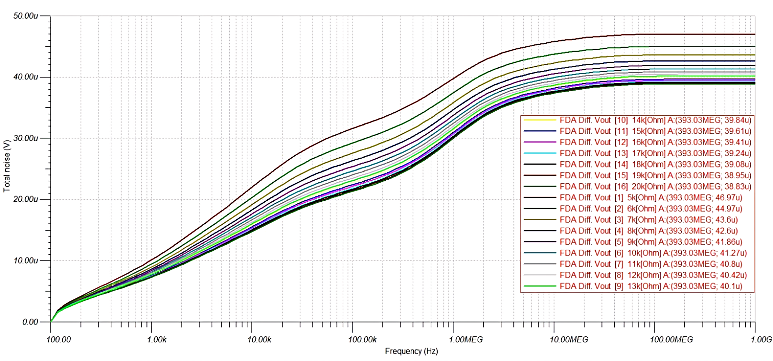
Total noise for the measurement range(5k-20k)Ω

Slide 36
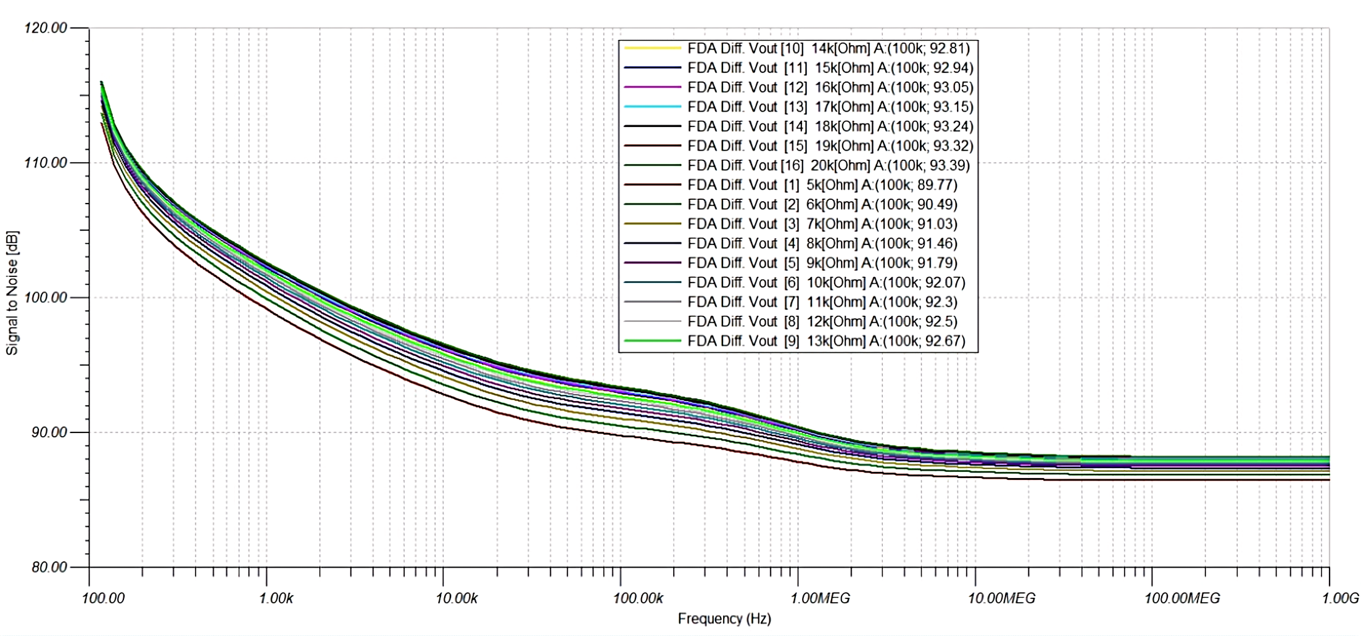
SNR values for corresponding measurement range(5k-20k)Ω

Slide 37
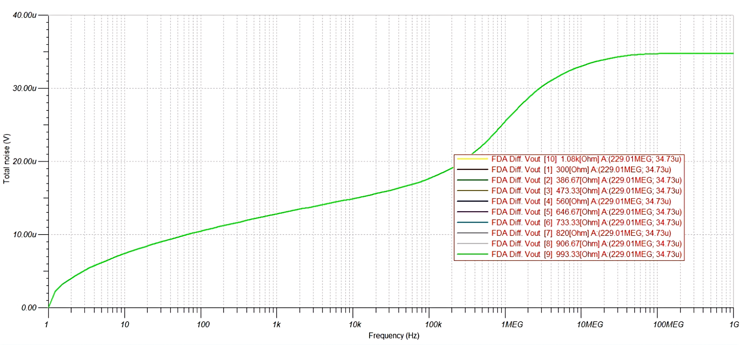
Total noise for the measurement range(300-1k)Ω

Slide 38
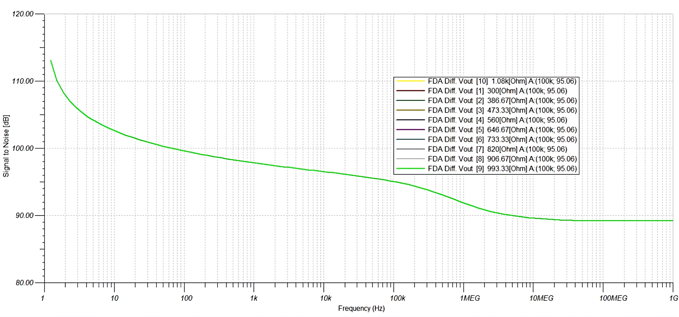
SNR values for corresponding measurement range(300-1k)Ω

Slide 39
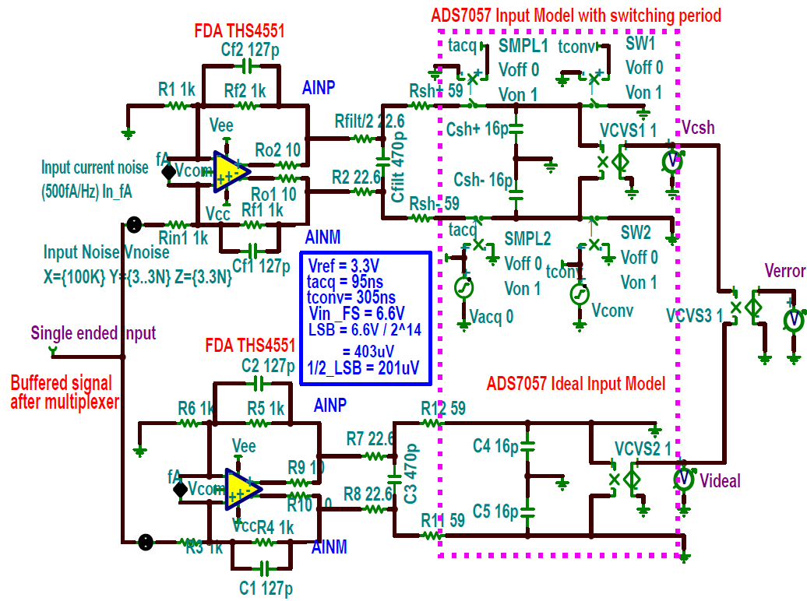
SAR ADC Settling error Analysis
Settling time includes a brief propagation delay and it ensures the output will reach the final value by overcoming the overload condition that is linked with the slewing. To prevent this from happening the sampled signal should be settled below the specified error level within the respective ADC acquisition time.
ADC driving equivalent circuit model for settling error measurement

Slide 40
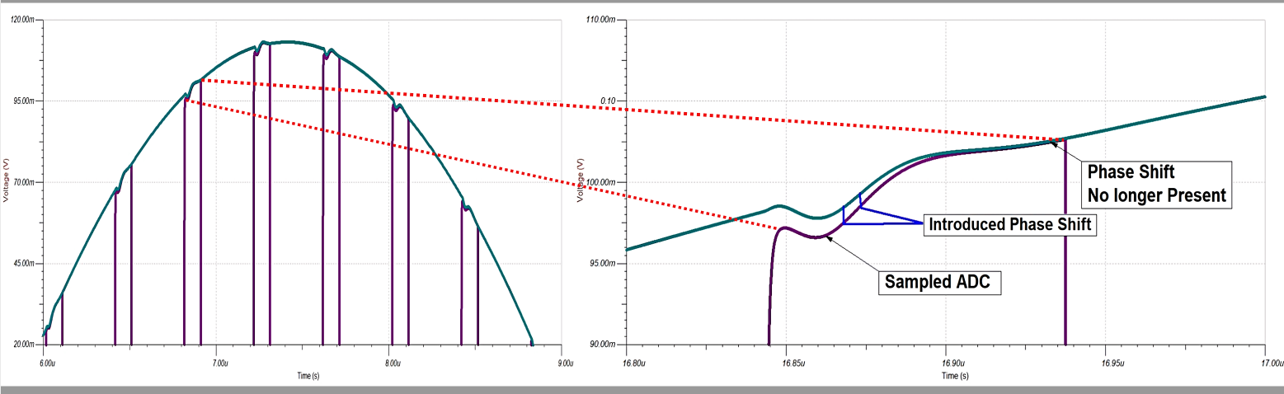
SAR ADC Settling error Analysis
The ideal signal and sampled signal of the ADC input and the settling error depiction obtained from the induced phase shift

Slide 41

SAR ADC Settling error Analysis
Typically the end point of every acquisition time (tacq) has been taken into consideration for checking the difference between the sampled and non-switching signal which refers to the settling error values.
the error has been checked at various point of the input sine wave to check whether the settling errors were always staying below target margin i.e. ±201 μV over the periods.

Slide 42


Settling Error Checking for Multiple Channels
the settling errors were always staying below target margin i.e. ±201μV at the end point of (tacq)

Slide 43


Settling time Calculation
The respective settling times (provided in the datasheet) of every individual component of the signal chain were being used in order to evaluate the total settling time given below
In order to avoid conversion error, a delay time (td) is added before the CONVST goes high. From the conversion period of the ADC, the maximum total time the signal gets to settle in is
tS = tACQ + tCONV − tD
tS = (95 + 305 − 10)ns = 390ns

Slide 44

Transient simulation to investigate settling period

Slide 45
Final Resultant Hardware Specifications
System Specifications
Power Supply Requirement
Main Power Supply | 24V DC
Input Voltages | ±5V,±2.5V, +3.3V, +1.65V
Power Start-up Time(Max) | 5.1 ms
Number of Electrodes | >=96
Measuring Impedance | (300-1k)Ω(Phase:6°-11°), (5k-20k)Ω(Phase:5.5°-9.8°)
Frequencies | 10kHz-100kHz
Sequence Scheme | Semi Parallel
Electrical Characteristics
Dynamic Characteristics
Selection of TIA Feedbacks | 240Ω for(300-1k)Ω ,5kΩ for(5k-20k)Ω
Excitation Voltage Amplitude | 1.05V DC(60mV p-p)
Presumed Electrode Currents | 900μA-190μA
Electrode current to voltage (TIA) value | 500mV-1V peak to peak
SNR ( at 100kHz frequency) | > 91dB
The total settling time | 369 ns (<tacq=400 ns)
Device Speed | 2.5 MSPS
Frames Per second | > 30fps (approximation)
ADC Driving Circuit Bandwidth | ∼=7.5MHz

Slide 46
Agenda
Theoretical Approach
Hardware Design Procedure
Simulation Analysis
Layout Design Description
Conclusion

Slide 47
Layout and Test Bench Analysis

Slide 48

Layout Design
Prototype Profiles:
Number of c
Dimensions:(142.24*83.820)mm
Number of Channels: 4
Layers: 2
GND Layer : Both Side
Electrode Connector Type: 50 ohm BNC
Board Connector Pins: 32
Track Width: 0.254 mm (Default)
0.4mm (Power Lines)
1.0 mm (High Power Line)
48
21.07.2022

Slide 49


Layout Test Bench Analysis
Figure: The test bench part in the layout
Testing Properties:
VC-EIT Schme
Multiplexer Sequence Scheme
Proposed Impedance Range Measurement Feasibilty
Test Bench 1 | |Z|= 300Ω , PD= -6.5° | Injection: 1, Record: 2,3,4
Test Bench 2 | |Z|= 1kΩ , PD= -6.5° | Injection: 2, Record: 1,3,4
Test Bench 3 | |Z|= 5kΩ , PD= -6.5° | Injection: 3, Record: 2,1,4
Test Bench 4 | |Z|= 20kΩ , PD= -6.5° | Injection: 4, Record: 2,3,1

Slide 50
50
21.07.2022

